Slide 1
Optimizing Firefighter Allocation for Wildfire Response
Benjamin Rio & Clara Schneuwly

Slide 2
I - Problem statement
Yearly economic burden of $400B for US. Suppression resources
Complex challenge: Unpredictable nature of fire spread
+ Varying effectiveness of suppression efforts
Current allocation methods rely on experience and local heuristic approaches
No efficient use of available data and predictive models
Our goal: Timely responses to more costly fires while
minimizing transportation costs

Slide 3
II - Data: 3 datasets from www.wildfire.gov for year 2015 to 2018.
+38k fire timed reports, with multiple reports per fire.
Methodic preprocessing to ”capture” the dataset at a given day.
Features:
Area of the fire on this day
Number of firefighters sent on this day
Maximum number of firefighters sent during any day
Distances between fires (Haversine and Euclidean).
FOCUS: 51 reported fires on August 1st, 2018

Slide 4
III - Methods
Baseline model: Treat fires in descending order of area.
Area-agnostic model: Allocate firefighters to minimize damage and travel costs.
Area-dependent model: Encouraging crews towards larger fires because they make more impact.
Dynamic network: Structure of directed network flow problem (less expensive than MIO)
Sequential set of nodes: each one represents the set fires at time t
Between two layers, nodes are fully connected
Direction given by the arrow of time : nodes at time t have directed edge towards each of the nodes of time t+1.
Cost of the edge between two nodes: distance between the two associated fires
Capacity of the edge between two nodes: infinite

Slide 5
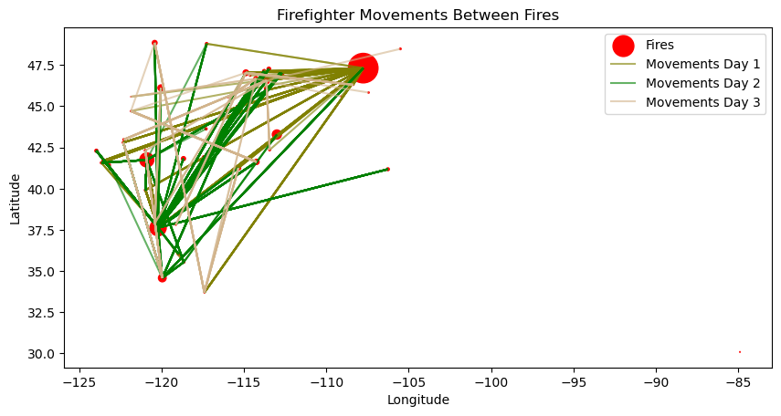
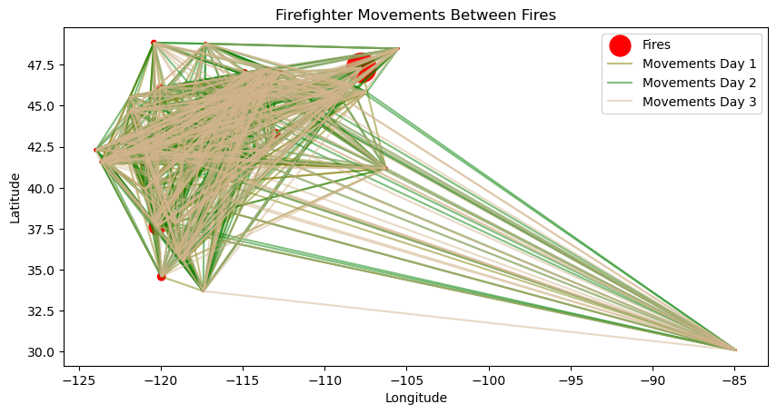
III - Results and Impact
Baseline
Area-agnostic
Fundamental wildfire management problem.
MIO: Edge from a management perspective
Dynamic graph: Smaller search space + relaxation is useful

